Slide 1
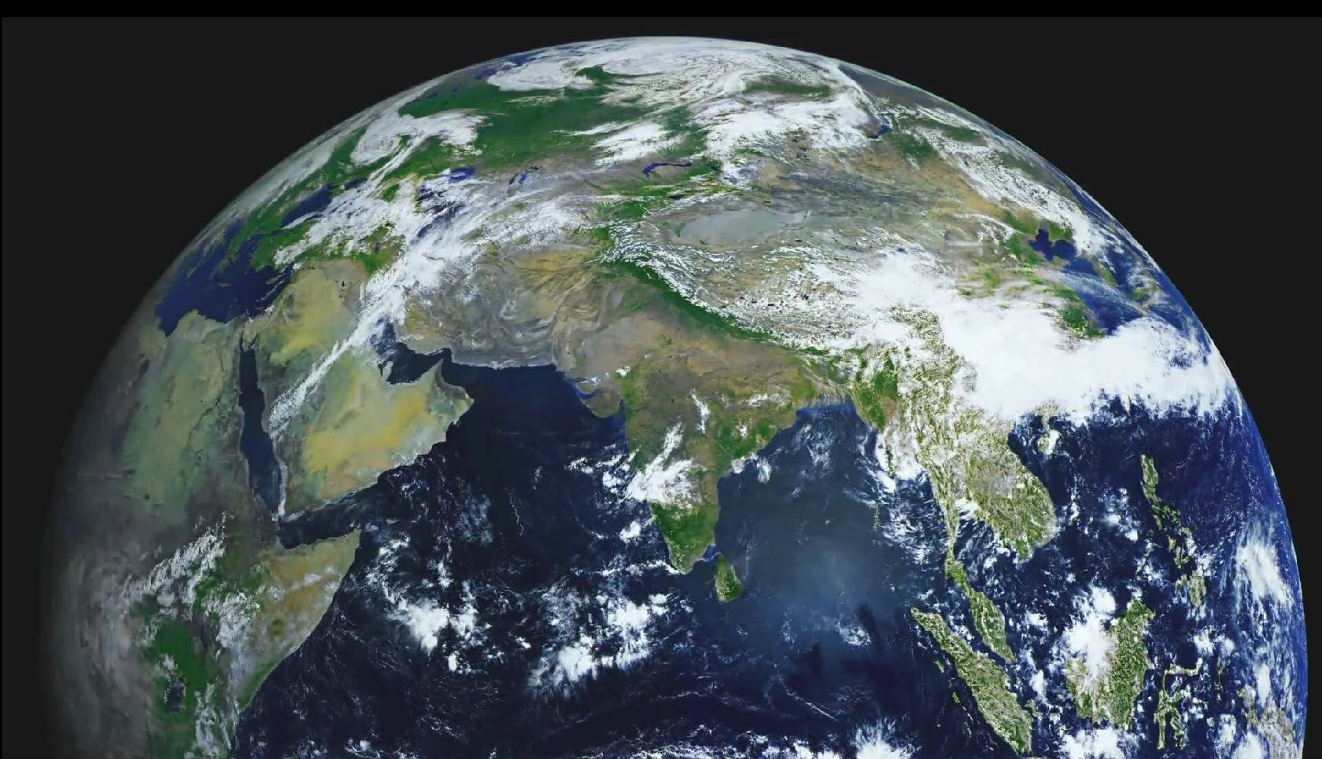
THE AMAZING
PLANT RACE

Slide 2
Round 1: Farmer’s field Eliminated: Lily Pad
Like a fish out of water, Lily Pad dried out early in the game
Lily’s need for water to survive and grow limits her and leads to her elimination in round 1
Because a farmer’s field does not have any surface water, Lily Pad couldn’t stay hydrated.
Many animals prowl around farmer’s fields and it might have been possible for them to find the racers.

Slide 3
Round 2: Peat Bog Eliminated: Paula Pine Tree
Paula, being extremely heavy (its all muscle, she’s a weight-lifter) sunk into the peat bog and floated away.
Paula Pine Tree’s weight ended up being a downfall in the second round.
The peat bog is extremely wet and doesn’t have a lot of solid ground.
Although there are many animals in the bog, few would feel the need to mess with a muscular pine tree like Paula.

Slide 4
Round 3: Semi Desert Eliminated: Hal Hornwort
This was a close match, Fern and Homer both were just holding on when Hal Hornwort dried up.
The Hornwort needs surface water, because there wasn’t any, Hal was eliminated in the 3rd round.
The Xinjiang semi-desert as the name suggests, doesn’t have a lot of water around, much less on the surface, where the hot sun would evaporate it on sight.

Slide 5
Round 3 Cont.
Its possible that animals living in the area could eat, or maybe even trample the contestants, however, Hal got dehydrated very quickly.

Slide 6
Round 4: African Savannah Eliminated: Fern, Marly Moss
Because Fern needs to live in water-rich soils, she planted herself by a water hole, but was eaten by the animals that drink there. Marly, on the other hand stuck to Garth Ginkgo to hide from the sun, the hot air, however dehydrated her and she shriveled up and fell off Garth.
Fern’s need for water-rich soils was her downfall, Marly’s was her lack of water storage ability.

Slide 7
Round 4 cont.
The environment played the major role in this round, the savannah lacking in surface water and not low on beating sunshine and heat was a harsh place for each contestant, but mostly for Fern and Marly Moss.
Predators played a role in Fern’s elimination, animals are always looking to keep themselves fed, and a water-rich plant like a fern would be a treat in the savannah.

Slide 8
Round 5: Amazon Rainforest Eliminated: Carla Cornstalk
This round was very quick, as soon as the contestants parachuted in, a wild animal dashed out of the woods and devoured Carla Cornstalk!
Carla’s sweet fruit was her downfall in this round and caused her elimination.
The rainforest itself did not contbute to Carla’s elimination.
The wild animal from the rainforest played the preditor in this round.

Slide 9
Final Round: Honolulu Winner: Garth Ginkgo
With only Homer Horsetail and Garth Ginkgo remaining, this match brought forth the winner, Garth Ginkgo.
Both Garth and Homer found themselves quite comfortable in Honolulu, this round was by far the longest because Homer Horsetail only lost because he died of old age (may he rest in peace)
The only reason Garth won was because of his long lifespan.
No predators played a role in this elimination.

Slide 10
Post-Race Analysis:
If the locations were reversed, I would still have named Garth the winner, the Ginkgo Tree is best fit to each environment.
I wouldn’t expect other students in the class to have a different answer, but I think some will because of their imaginations.
No better plants come to mind, but I think that a more hardy Angiosperm may have less trouble in each environment.

